Slide 1
WorkshopPLUS – Power Apps for Power Users 1 Day with Lab Module 4: Implementing through visual designs

Slide 2
Disclaimer

Slide 4
Control variations and grouping
Display user data
Add Power Apps to SharePoint via Power Apps web part
Integrating Power Apps and Teams
Introduction to Power Automate

Slide 5
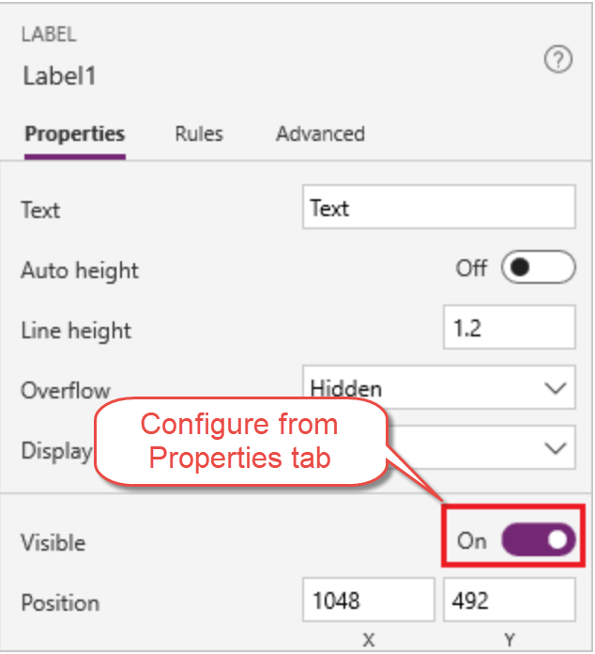
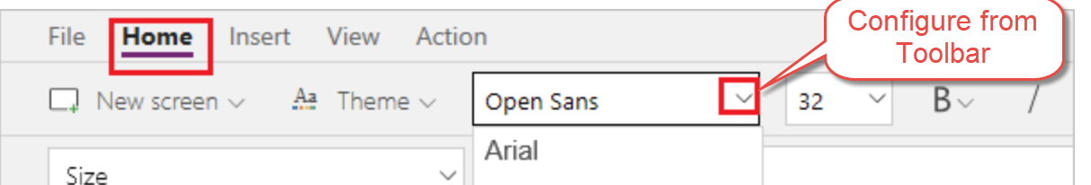
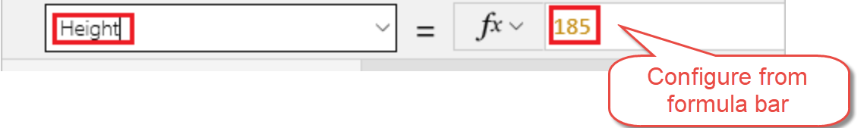
Control variations
Notes:
Mention:
Add a variety of UI elements to your canvas app, and configure aspects of their appearance and behavior directly, from the toolbar, in the Properties tab, or in the formula bar. These UI elements are called controls, and the aspects that you configure are called properties.
Actions you can take:
Rename control
Delete control
Reorder screens
Move and resize controls
Change the text of a label or a button
Use Toolbar, Properties Tab, or Formula bar to configure a control
When configuring a control common properties you can affect:
Color and border – Configure the color and border of a control that can change as a user interacts with it.
Core – Configure whether the user can see and interact with a control.
Image – Configure what image is shown and how it fills the control.
Size and location – Configure how big a control (or an element of a control) is and where it is in relation to the screen it's on.
Text – Configure how text appears in controls, such as font characteristics, alignment, line height.
** See the following for more info https://docs.microsoft.com/en-us/powerapps/maker/canvas-apps/reference-properties
https://docs.microsoft.com/en-us/powerapps/maker/canvas-apps/add-configure-controls

Slide 6
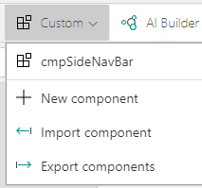
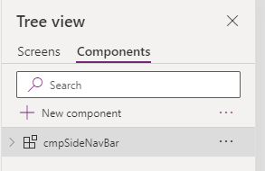
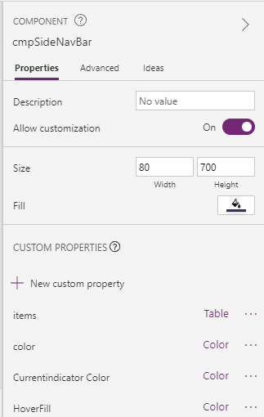
Components
Notes:
Mention:
Canvas components make it easier to build reusable controls, such as navigation menus or set of buttons/text boxes or labels by grouping controls together in a reusable instance. The behavior makes it easy to reuse them as building blocks inside the app
Developer can choose properties to represent there ‘Component’
Each instance has it’s own version of all properties
Discuss:
In the Tree View, select “Components” and you will land on a square canvas.
Click New Component, then Add controls that you want to group
Click back to screens on right side select ‘Components’ and then select your component and added it to screen

Slide 7
Design Screens and Controls
Objectives
After completing this lab, you will be able to:
Add Compare Screen
Remove and add controls to the gallery
Highlight selected device
Add icon to navigate
Test the app
Scenario
The organization wishes to build apps using the Power Apps platform to take advantage of No Code/Low Code application development in the cloud. As part of this effort, you are required to add compare screens, add/remove gallery controls, manipulate the navigation, and test the functionality of your app.
Notes:
See lab file M4.1_PowerApps_PowerUser_ImplementingthruVisualDesigns.docx and complete tasks 1 - 2

Slide 8
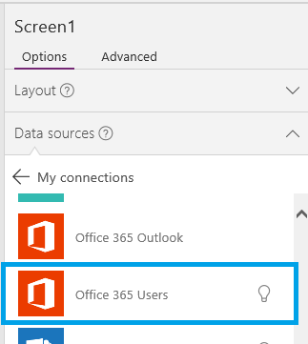
Display user data - Configure connection
Sign up for Power Apps
Start with template
Connect to Data – New Connection
Select Office 365 Users
Notes:
Sign up for PowerApps
Go to Power Apps site to sign up or see what kind of license you are assigned
Start with Template
From the Home tab go to Start from Blank and select Make this App
Connect to Data – New Connection
Once you click on New Connection you will be presented with a list of Connection Types
Select Office 365 Users
Select Connect, when prompted enter your credentials.
The Office 365 Users connection has been created and added to your app. Now, it's ready to be used.
https://docs.microsoft.com/en-us/powerapps/maker/canvas-apps/add-data-connection
https://docs.microsoft.com/en-us/powerapps/maker/canvas-apps/connections/connection-office365-users
https://docs.microsoft.com/en-us/connectors/office365users/

Slide 9
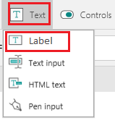
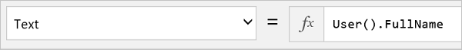
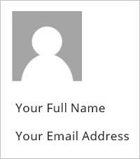
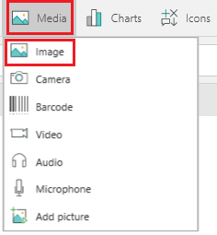
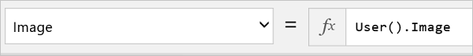
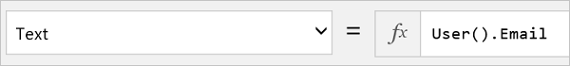
Display user data – Current user
Notes:
Discuss:
Does not require O365Users Connector
On the Insert tab, click or tap Media, and then click or tap Image.
Set the Image property to this formula: User().Image
On the Insert tab, click or tap Text, and then click or tap Label:
Set the Text property to this formula: User().FullName
Add another label and set its Text property to this formula: User().Email
User() Record of all information for the current PowerApps user. { FullName: "John Doe", Email: "john.doe@contoso.com", Image: "blob:1234...5678" }
User().Email The email address of the current PowerApps user. "john.doe@contoso.com"
User().FullName The full name of the current PowerApps user. "John Doe"
User().Image The image URL for the current PowerApps user. Set the Image property of the Image control to this value to display the image in the app.
https://docs.microsoft.com/en-us/powerapps/maker/canvas-apps/functions/function-user

Slide 10
Display user data – Users, managers, and direct reports
Office365Users.MyProfile()
Office365Users.UserProfile(<UPN> or Email ID)
Office365Users.Manager(<UPN> or Email ID)
Office365Users.DirectReports(<UPN> or Email ID)
Available properties: Department, DisplayName, GivenName , Id, JobTitle, Mail, MailNickname, Surname, TelephoneNumber, UserPrincipalName, and AccountEnabled
Notes:
Mention:
There are V2 of these functions which provide more properties
Discuss:
TextBox to get UPN or Email ID **You can use a formula to pull from another location
https://docs.microsoft.com/en-us/powerapps/maker/canvas-apps/connections/connection-office365-users
You can add the following to a label:
Office365Users.MyProfile(): DisplayName for current user
Office365Users.MyProfile().DisplayName
Office365Users.UserProfile(<UPN> or Email ID): DisplayName of jsmith@contoso.com
Office365Users.UserProfile(jsmith@contoso.com).DisplayName
Office365Users.Manager(<UPN> or Email ID): DisplayName for the Manager of jsmith@contoso.com
Office365Users.Manager(jsmith@contoso.com).DisplayName
Office365Users.DirectReports(<UPN> or Email ID): DisplayName of all direct reports for jsmith@contoso.com
Office365Users.DirectReports(jsmith@contoso.com).DisplayName

Slide 11
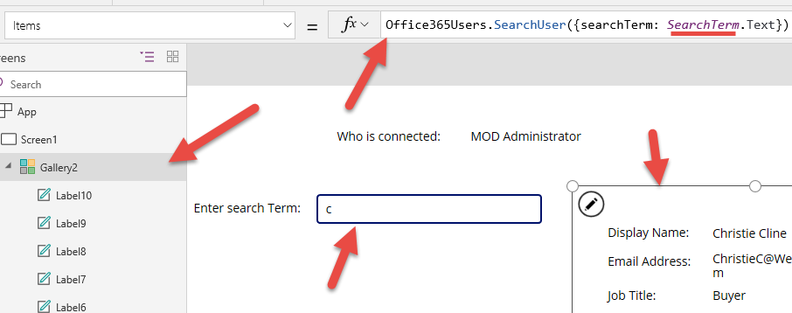
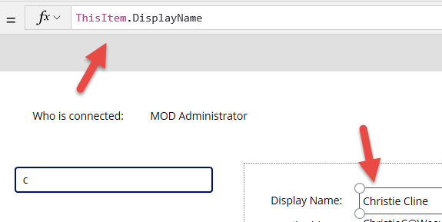
Display user data – Search for users
Note: Functions are case sensitive ‘searchTerm’ must have upper case “T”.
Notes:
Mention:
Search string. Applies to: display name, given name, surname, mail, mail nickname, and user principal name
Function are case sensitive in PowerApps Studio
Discuss:
Add Text Box and Rename to SearchTerm enter a value like ‘c’
Add a Gallery to screen set Items property to ‘Office365Users.SearchUser({searchTerm: SearchTerm.Text})’
Design Gallery to include Labels with meaning Text = ThisItem.DisplayName
Available properties Department, DisplayName, GivenName , Id, JobTitle, Mail, MailNickname, Surname, TelephoneNumber, UserPrincipalName, and AccountEnabled

Slide 12
Display user data
Add functionality to app to show current user and manager in Power Apps

Slide 13
Configuring your App to be Responsive
Step 1: Before designing consider the following:
What form factors are supported?
What elements need to stretch or resize?
How does the app look on each supported form factors?
Are you hiding elements on certain form factors?
Does the app have different behaviors between form factors?

Slide 14
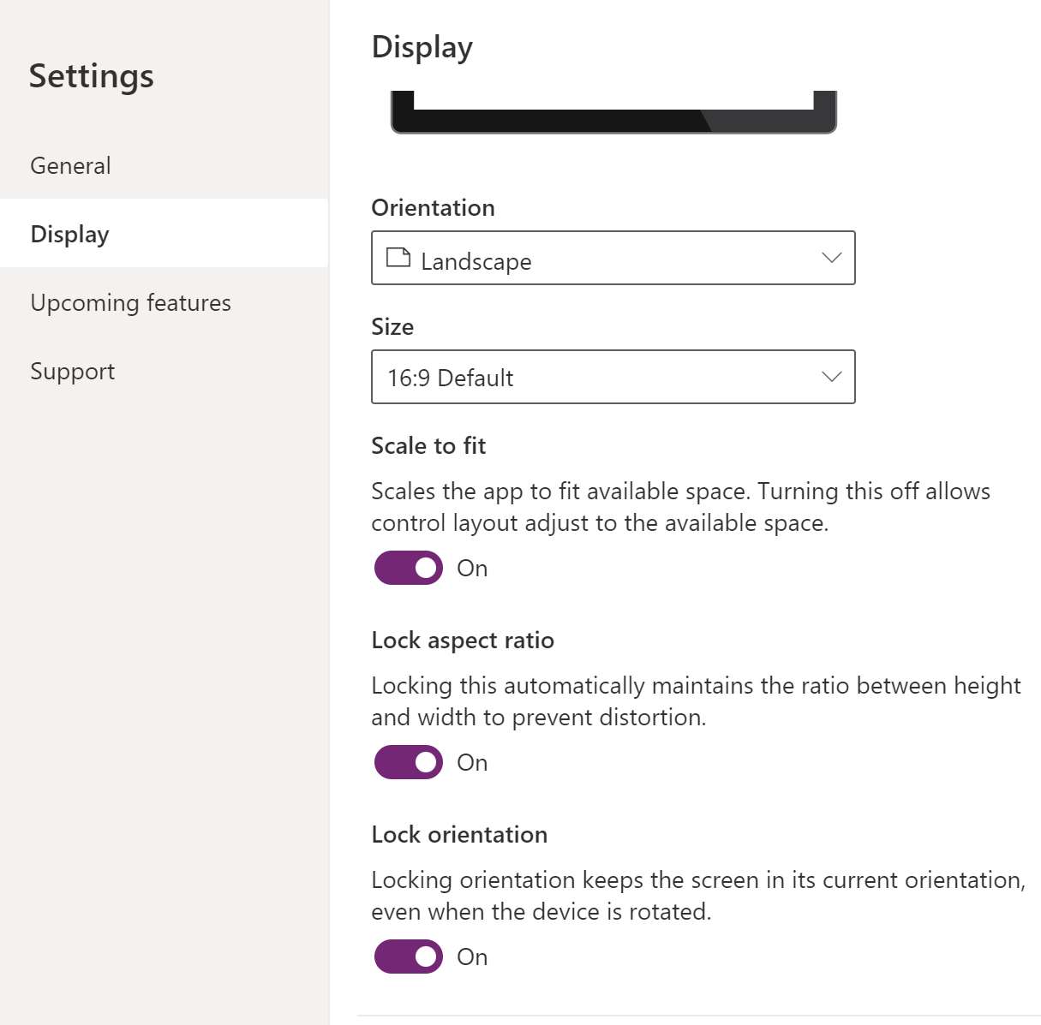
Configuring your App to be Responsive
Step 2: Configure settings to enable Responsive layout
Go to https://make.powerapps.com
Edit the app that needs to be responsive.
Go to File > Settings > Display and turn off ’Scale to fit’, ’Lock aspect ratio’, and ’Lock orientation’.
Then close screen.

Slide 15
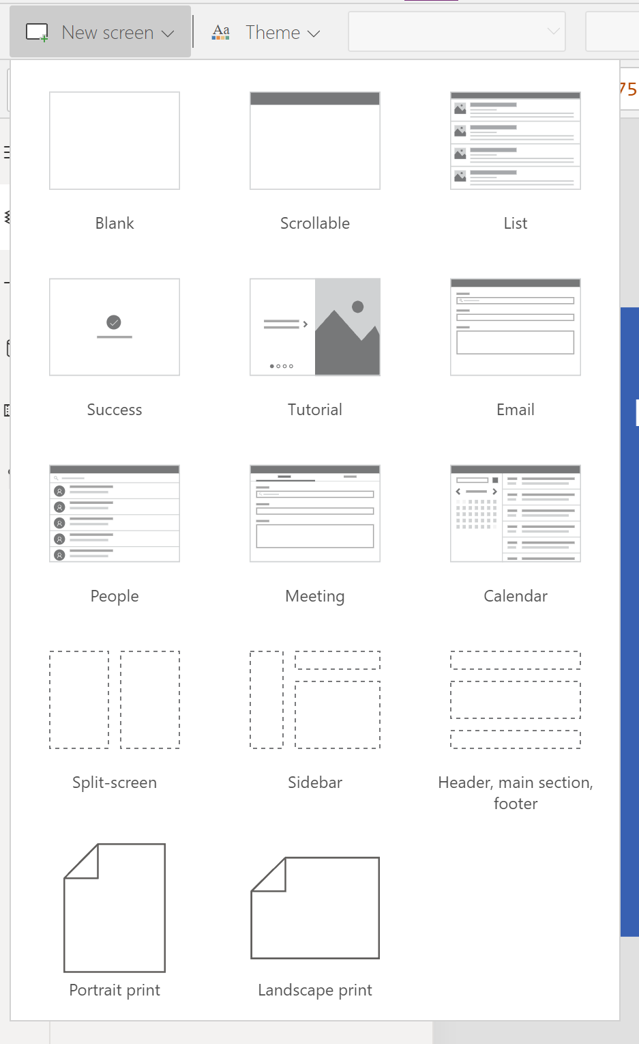
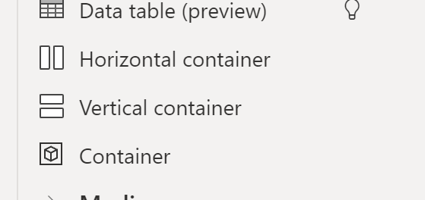
Configuring your App to be Responsive
Step 3: Using pre-created layouts vs Containers
Layouts are preconfigured easy to use but you have only 3 layouts
Split-screen
Sidebar
3 sections
Containers allow more flexibility but require configuration
Vertical
Horizontal
Constrained
Notes:
Discuss
You add controls to containers
Containers can be nested, and you need to set one container to fill the whole screen, then nest other containers within that
Containers have the following properties to consider
Align
Fill portions
X,Y
Width Height
Auto-layout containers (Vertical or Horizontal) are good in the following situations
UI needs to be responsive to screen size or form factor changes.
There is more than one child component that needs to resize or move around based on the screen size or form factor changes.
When you need to stack items vertically or horizontally (regardless of their size).
When you need to space items evenly on the screen.

Slide 16
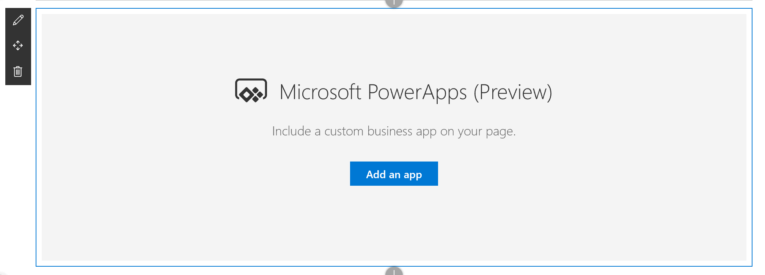
Adding Power Apps to SharePoint via web part
Notes:
Mention:
Before web part users would use iFrame and embed Power Apps app in page (See this for more info https://powerapps.microsoft.com/en-us/blog/embed-powerapps-on-sharepoint-pages/)
Only works for Modern pages
Adding the app on a page does not automatically give users permissions to use the app.
Power Apps are designed to work best with fixed sizes.
The Power Apps (preview) web part for SharePoint Online does not yet support screen readers or keyboard navigation.
Discuss:
Hover your mouse above or below an existing web part click , then select the Power Apps web part.
Click Add an app button
In the property pane on the right, enter the Power Apps web link or app ID in the App web link or ID box.
If the default size of the app is too small or doesn’t fit the page, then resize the app by dragging the resize button on the bottom right of the web part.

Slide 17
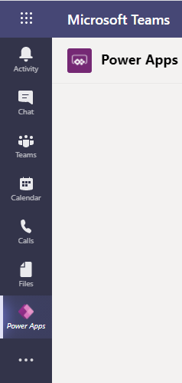
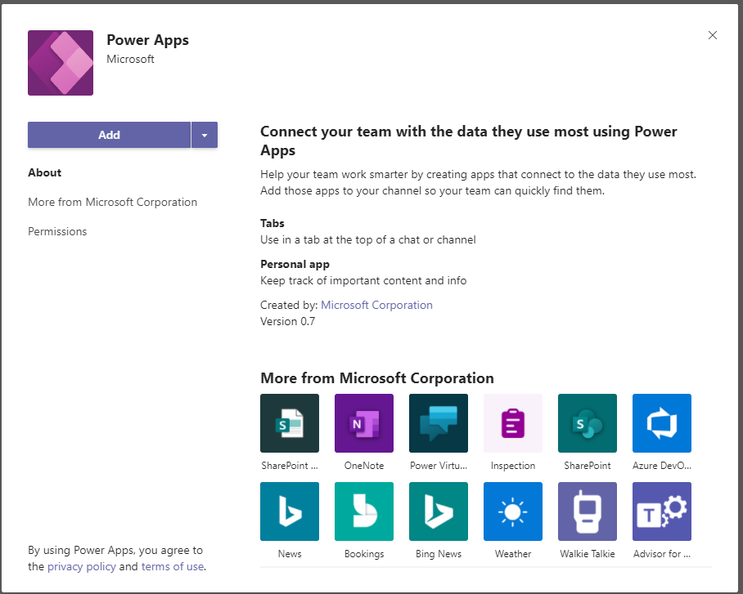
Integrating Power Apps and Teams
Add to Teams like any other app
Create apps to access Dataverse for Teams, SharePoint list, or other repositories.
Add as a Tab to help find them
Notes:
Discuss
Currently canvas app only
Connectors are still Premium/Standard and require appropriate Power Apps license
Apps are stored in Dataverse for Teams environment
Creation of app does not automatically add as tab

Slide 18
Design gallery and navigation
Objectives
After completing this lab, you will be able to:
Add Compare Screen
Remove and add controls to the gallery
Highlight selected device
Add icon to navigate
Test the app
Scenario
The organization wishes to build apps using the Power Apps platform to take advantage of No Code/Low Code application development in the cloud. As part of this effort, you are required to add compare screens, add/remove gallery controls, manipulate the navigation, and test the functionality of your app.
Notes:
See lab file M4.1_PowerApps_PowerUser_ImplementingthruVisualDesigns.docx and complete tasks 3 - 6

Slide 19
What do we mean accessibility?
An accessible app will allow users with vision, hearing, and other impairments to successfully use the app or studio.

Slide 20
Who can we help?
User
Maker
Notes:
Maker is any developer/citizen developer who creates an App
User is any licensed person that consumes

Slide 21
How can we help?
Provide both Users and Makers access to Power Apps while using Assistive technologies
Makers need to follow guidelines as outlined by Microsoft
Makers need to follow WCAG guidelines from W3C
Makers should use Accessibility section of App Checker
Notes:
Assistive Technologies in Power Platform – Both developer tools and Power Apps use Assistive technologies like Screen Reader
Web Content Accessibility Guidelines (WCAG) - Developed through the W3C process in cooperation with individuals and organizations around the world, with a goal of providing a single shared standard for web content accessibility that meets the needs of individuals, organizations, and governments internationally
https://www.w3.org/WAI/standards-guidelines/wcag/
Microsoft Guidelines – Guidelines provide design solutions to help makers to design UI that works with Assistive technologies or provide a better experience for people with impairments
https://docs.microsoft.com/en-us/powerapps/maker/canvas-apps/accessible-apps
Makers should use Accessibility section of App Checker – Within App Checker in Power Apps Studio there is a section that will tell you what changes to make the app more accessible
https://docs.microsoft.com/en-us/powerapps/maker/canvas-apps/accessibility-checker

Slide 22
Microsoft Guidelines
Optimize Layout and Color
Provide Keyboard Support
Provide Screen Reader Support
Working with Multimedia
Working with Signatures
Notes:
Optimize Layout and Color
Provide a common sense and uncomplicated design
Microsoft Power Apps themes are designed to meet accessibility standards look to use them first
Ensure input elements are labeled on the screen. i.e.. AccessibilityLabel property defines what the screen reader will announce
When customizing colors, ensure the contrast of text:background is 4.5:1 or greater. Software tools that assist this process are readily available.
Ensure layout follows a logical flow when read top-bottom, left to right
Ensure App UI flow Left to Right and Top to Bottom
Provide Keyboard Support
Ensure the app can be used with the keyboard only if needed
Ensure the app can be navigated successfully with the screen reader enabled
Label, Image, Icon, Shape controls - if they represent interactive elements (ie.buttons) set TabIndex to 0; if they are decorative elements or text, set TabIndex to -1
Avoid setting tab index higher than zero
Provide Screen Reader Support
Recommended software combos
Windows: Microsoft Edge / Narrator
macOS: Safari / VoiceOver
Android: Power Apps app / Talkback
iOS: Power Apps app / VoiceOver
Ensure all input controls have the AccessibilityLabel property set
Ensure images set AccessibilityLabel to an appropriate description, except when a picture is there just for the decoration (i.e.. Company logo) and should not be read by the screen reader, in that case the AccessibilityLabel is empty or not set
Ensure if a picture or an icon is used as a button, then set TabIndex to 0 and AccessibilityLabel to the link description
Working with Multimedia
Ensure all videos are captioned and a transcript of all audio recordings is available to the user
Video control supports closed captions in WebVTT format via the ClosedCaptionsUrl property
Working with Signatures
If using PenInput have a Keyboard only method for users to sign i.e. TextInput control

Slide 23
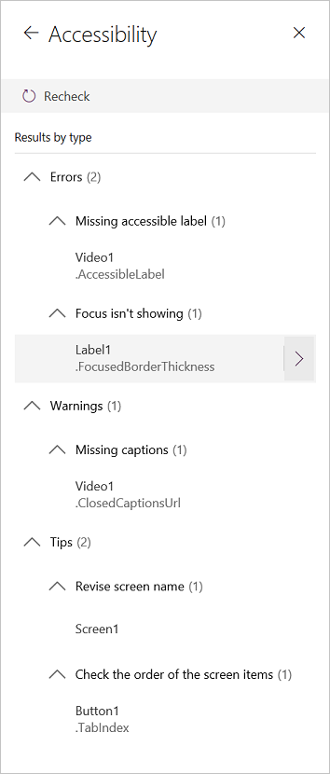
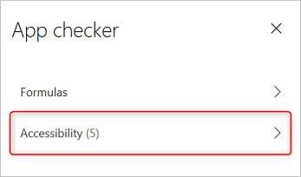
Using App checker for Accessibility
Finds potential accessibility issues but also explains why each might be a potential problem
Detects screen-reader and keyboard issues for you
Notes:
The Accessibility checker provides following classification
Errors identify issues that make the app difficult or impossible to use and understand for users who have a disability.
Warnings identify issues that make the app difficult to use or understand for most but not all users who have a disability.
Tips help you improve the experience of users who have a disability.

Slide 24
Connect data to your Canvas App
Objectives
After completing this lab, you will be able to:
Connect SharePoint list as data source
Configure and add form
Submit Form
Test the app
Scenario
The organization wishes to build apps using the Power Apps platform to take advantage of No Code/Low Code application development in the cloud. As part of this effort, you are required to add new data source (SharePoint list), configure, add and submit form, add/remove gallery controls, manipulate the navigation, and test the functionality of your app.
Notes:
See lab file M4.1_PowerApps_PowerUser_ImplementingthruVisualDesigns.docx and complete all tasks

Slide 25
Introduction to Power Automate

Slide 26
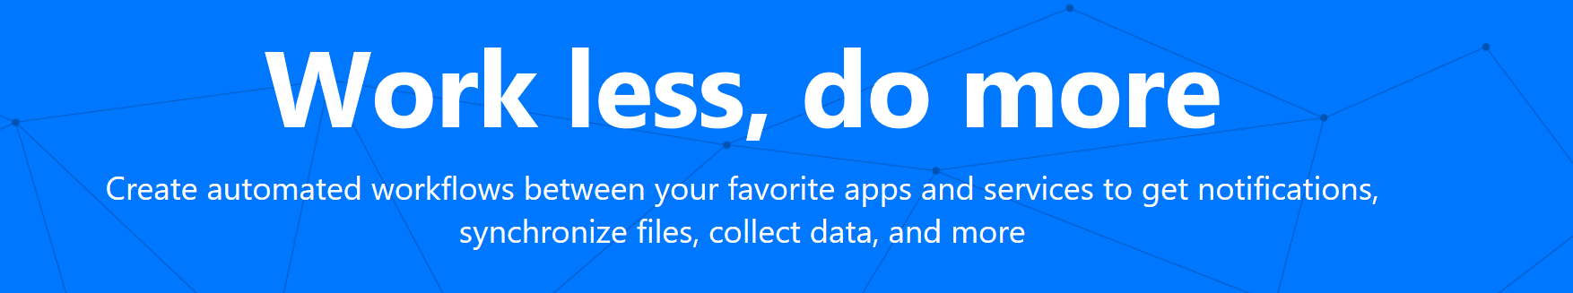
Power Automate introduction
Create workflows integrated to multiple data sources including
Microsoft 1st party services and 3rd party vendors.
Notes:
Use flow to automate business process by building easy, declarative workflow that can talk to multiple data sources including Microsoft 1 party services like SPO, other Office 365 workloads as well as 3rd party vendors.

Slide 27
Power Automate flow process
Trigger
A trigger is a condition or check that will kick off a flow
If the trigger condition is successfully met any number of subsequent actions can take place.
Actions
Each flow can only have 1 trigger
Ex. …look up the current user’s profile and then email that user’s manager
Ex. When a new SharePoint list item is created…
Notes:
A flow process is basically divided into 2 parts – trigger and action. There can only be 1 trigger action in a flow which basically kicks off the flow. An example of trigger could be when a new item is added to a SharePoint list or when someone tweets you
Trigger is followed by an action, that is where you perform the work you want. There can be as many actions as you want. Ex Perform arithmetic, update a record, send an email

Slide 28
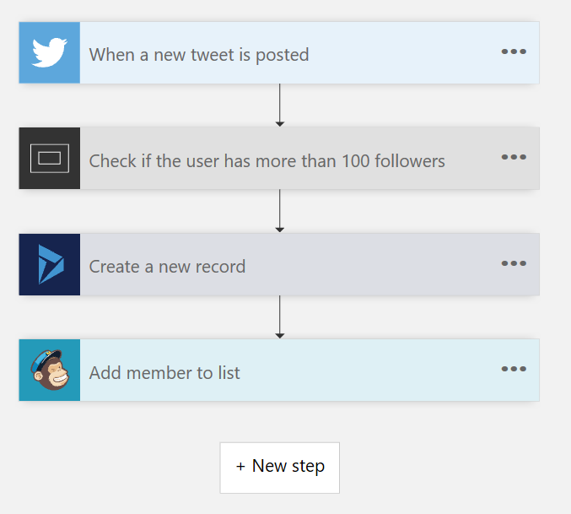
Multistep flows
Turn repetitive tasks into multistep workflows. For example, with a few clicks capture tweets and add them as leads in Dynamics 365, subscribers in Mailchimp, and more.
Notes:
Using multiple actions that pass properties between each other or somehow interact with each other to create a bigger process.

Slide 29
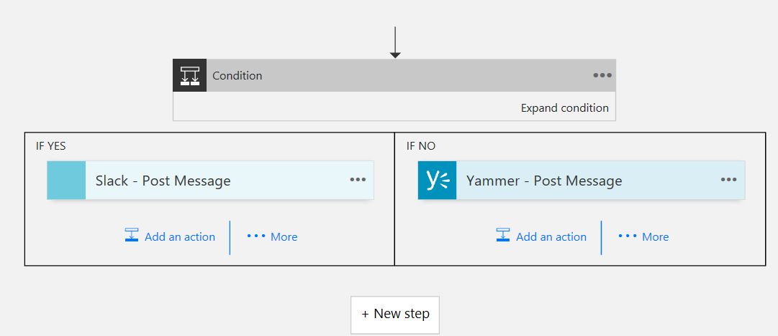
Conditions/loops
Conditional logic and loops can direct the flow to branch, repeat, or change how data is processed based on values within the flow.
Notes:
Conditions allow you to create if-then logic an example would be looking at a user profile and if the Job Title has the word executive in it then you take one branch of logic but for everyone else you take a different branch of logic.
Loops allow you to perform the same logic branch repeatedly till you tell it to exit an example would

Slide 30
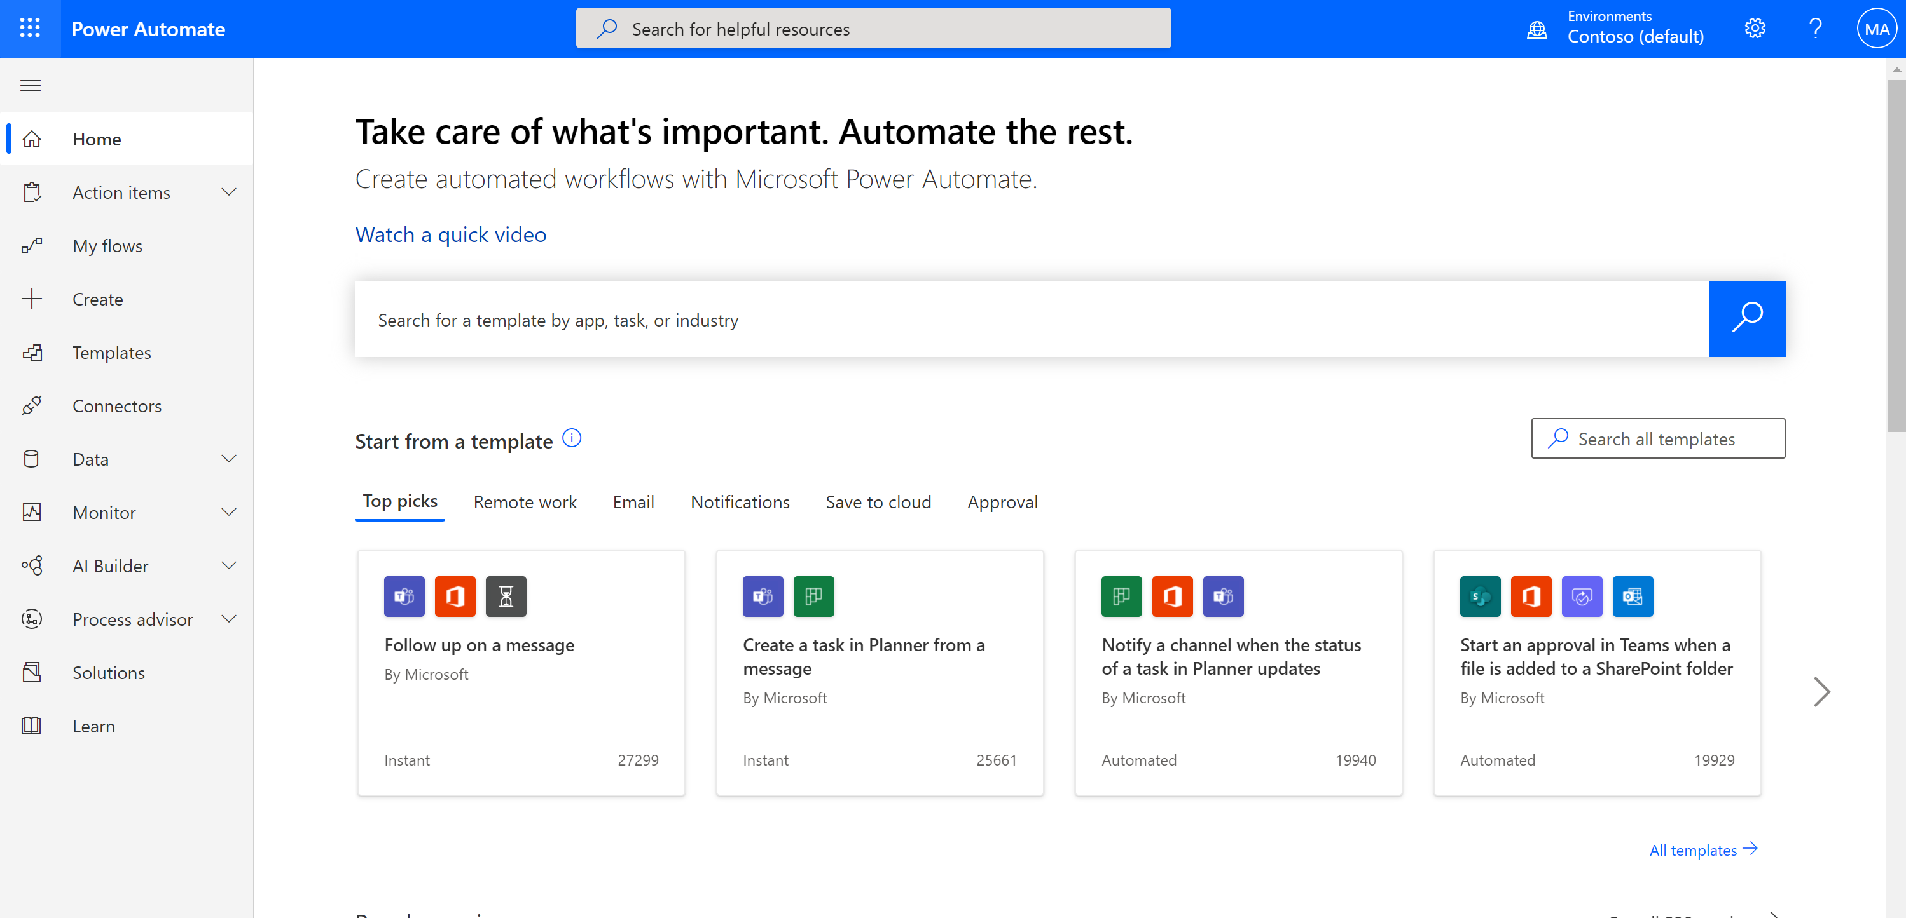
Power Automate portal
https://flow.microsoft.com/
Notes:
How do you get started? By going to the portal – flow.microsoft.com

Slide 31
Power Automate studio
Navigate to Power Automate studio and show different sections and functionality
Notes:
Go to http://flow.Microsoft.com and log in
Review at least the following sections: Home, My Flow, Create, Templates, Connectors

Slide 32
Build your own flows in an easy-to-use visual designer (optional)
Objectives
After completing this lab, you will be able to:
• Add triggers to flow
• Add steps to flow
• Add Actions to flow
• Configure ‘Send an Email’ action in flow
• View all your flows
• View flow history
• View flow run details
Scenario
The organization wishes to automate business process using the Power Automate to take advantage of No Code/Low Code workflow development in the cloud. As part of this effort, you are required to create a POC to show how a user could automate a simple process.
Notes:
See file M4.3_Build_your_own_Flows_in_an_easy-to-use_visual_designer.docx complete all tasks

Slide 33
Control variations and grouping
Display user data
Add Power Apps to SharePoint via Power Apps web part
Introduction to Power Automate

